Slide 1
EchoPlay
B11901150 易靖杰
B11901173 陳顗帆

Slide 2
Outline
Motivation
Implementation
STM
RPI
Results & Demonstration
Reference

Slide 3
Motivation
Recent advancements in edge computing and AI enable efficient, responsive systems by combining low-power microcontrollers with capable servers.
STM32 microcontroller as a low-power edge processor, Raspberry Pi runs machine learning model.
Aligns with edge computing trends like localized processing, reduced latency, and privacy protection by minimizing raw data transmission.
Demonstrates a practical, and energy-efficient IoT solution using computing techniques learned in class.

Slide 4

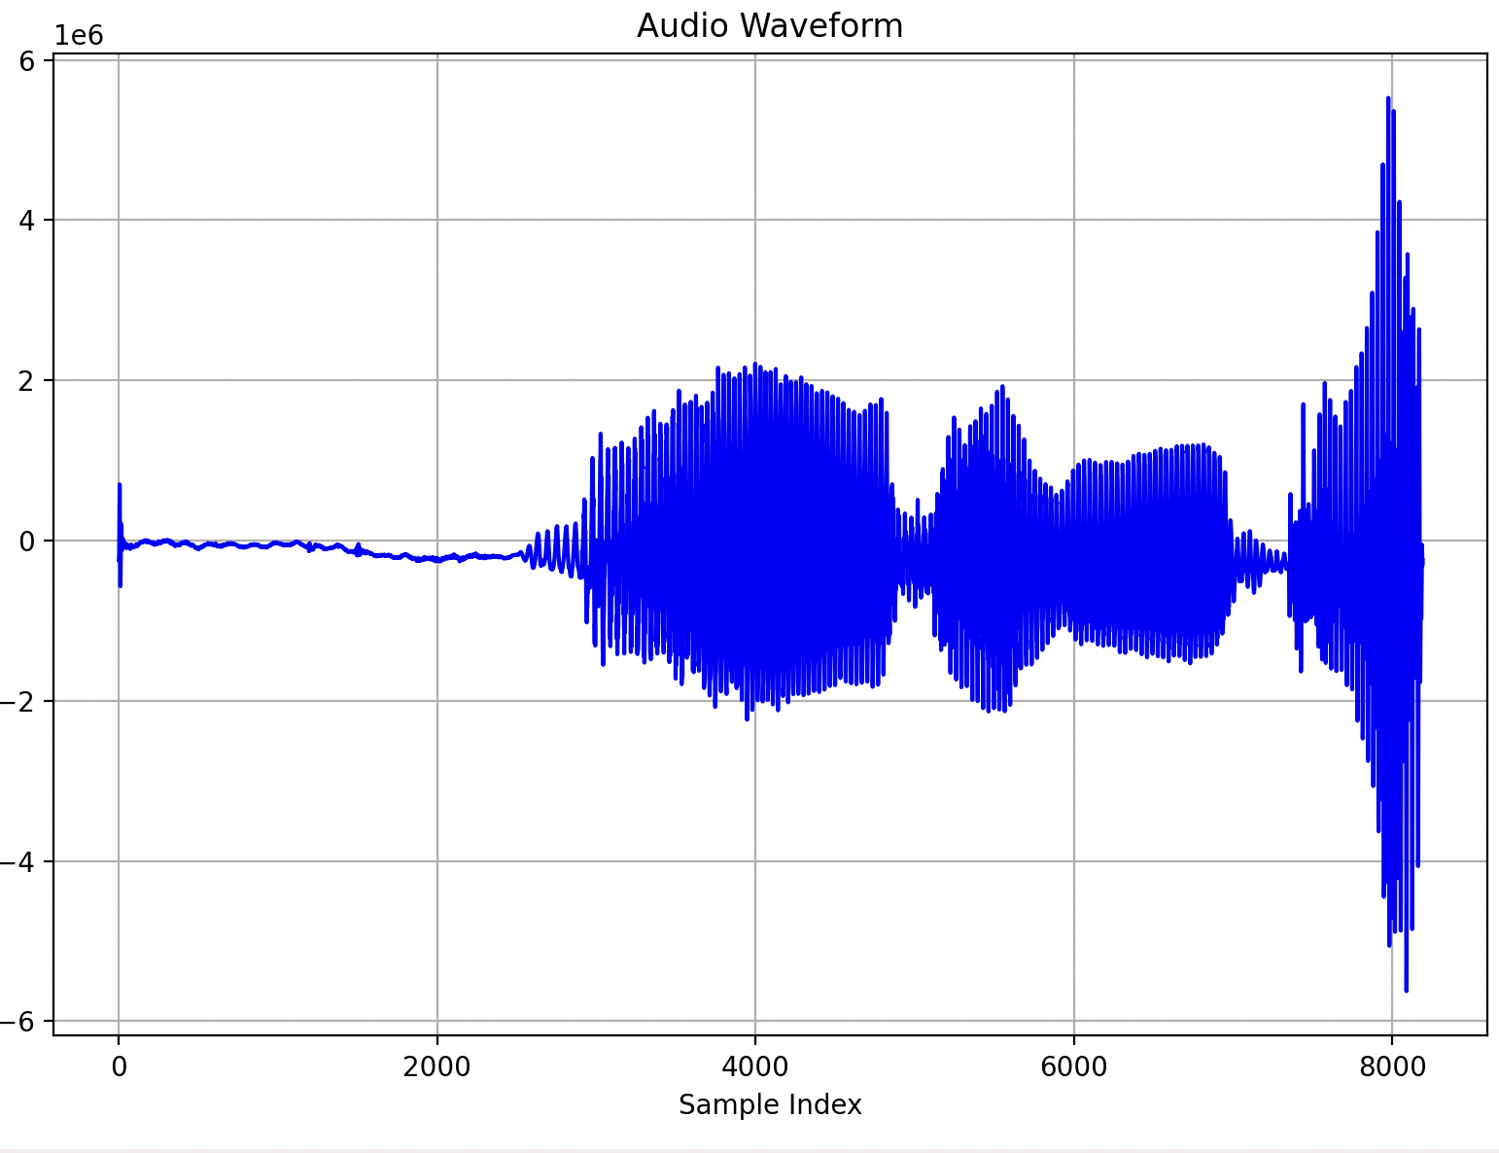
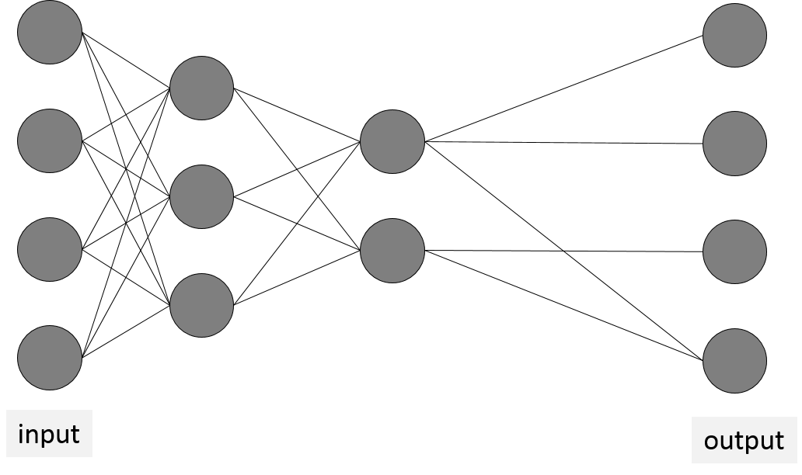
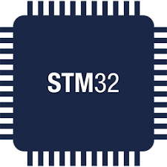

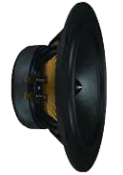

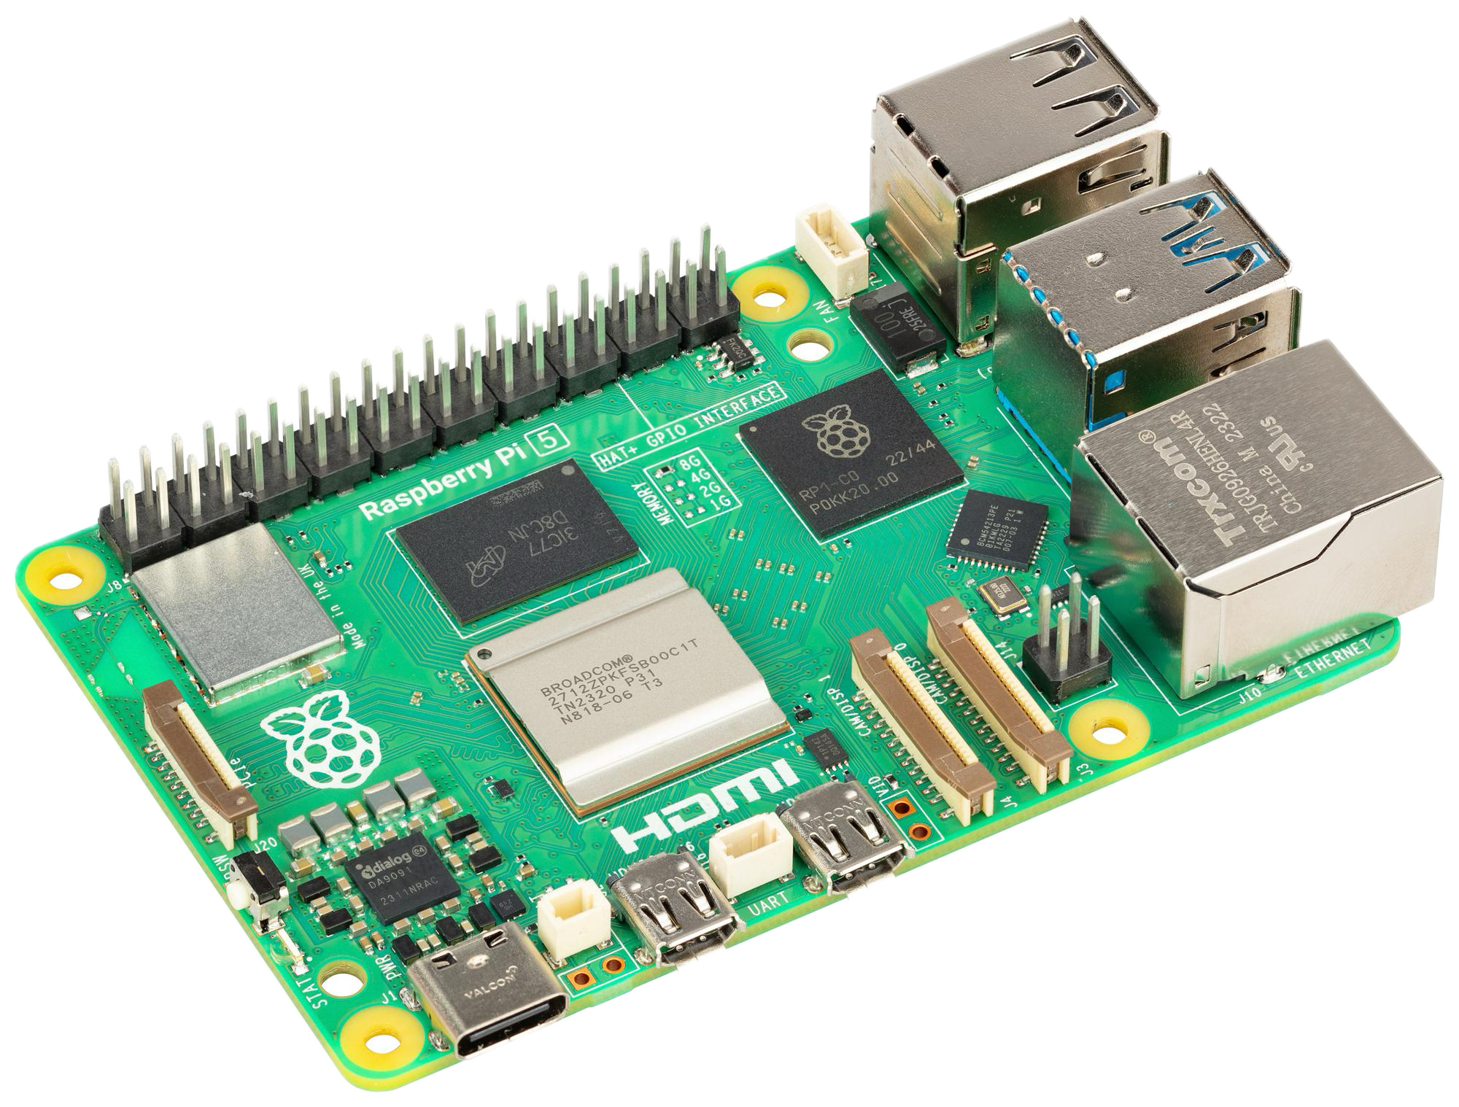
Implementation
Voice Controller: STM32
AI Server: RPI
Bluetooth Speaker

Slide 5
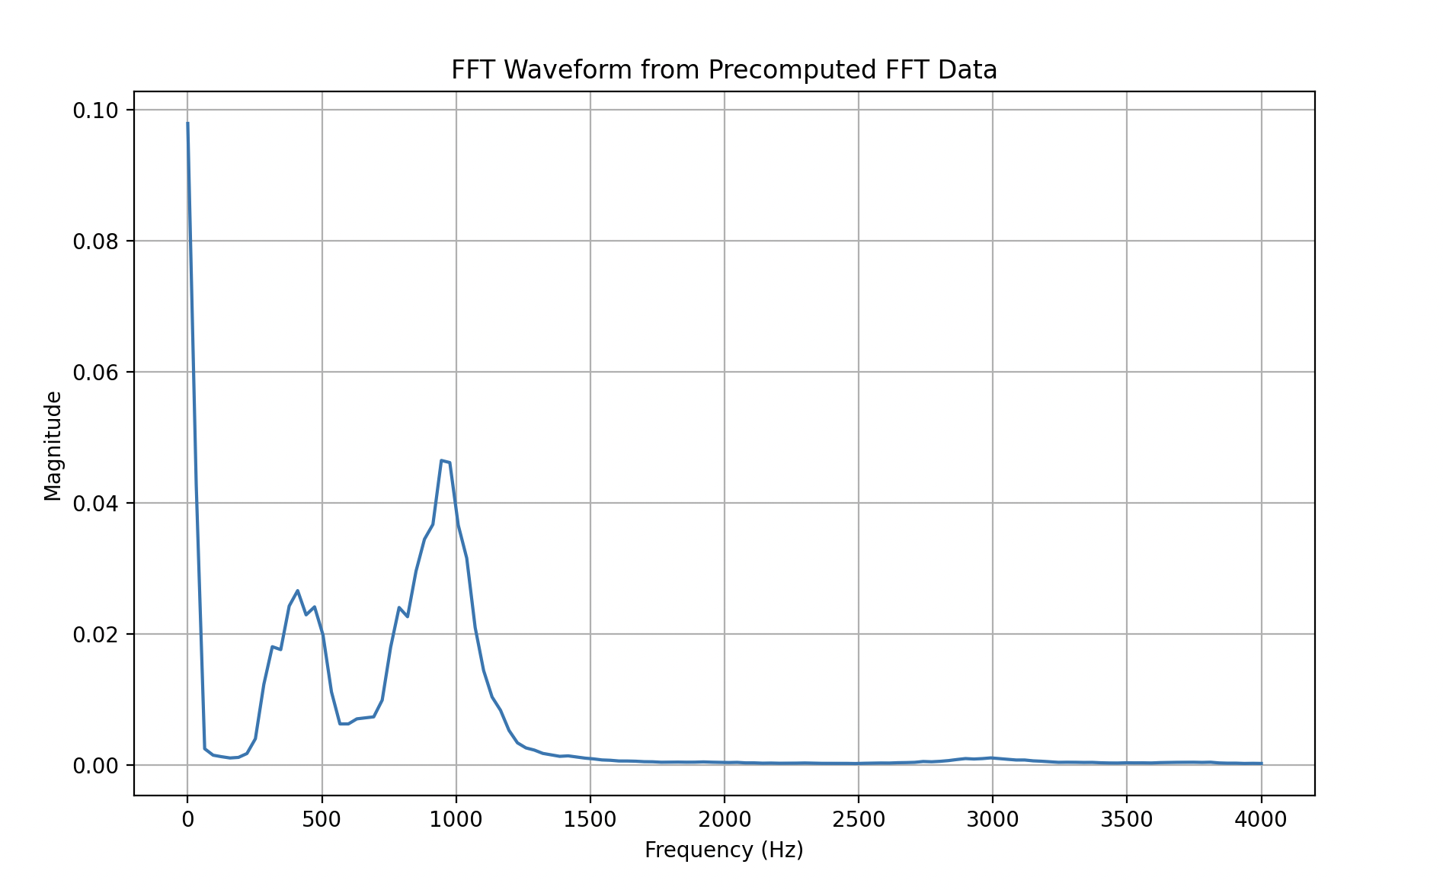
STM32
Goal: Act as an IoT edge preprocessing device. Use Real Time OS and onboard sensors to efficiently record audio data and process for ML model then send to RPI.
WIFI to Server

Slide 6
STM32 - Audio & DMA
Challenges:
Size of STM32’s onboard memory size
Size of TCP transmission packet
Processing time
Cannot pause DMA during 1 second recording
Solution
For precision, choose largest possible recording array: int32 [8192]
Use RTOS to start preprocessing IN ADVANCE
Divide into smaller packets to avoid transmission error

Slide 7
STM32 - Audio & DMA
While DMA is processing one half of the array, we can use RTOS to preprocess the other half
DMA
Raw Audio Data
DMA continues to Load sensor data into lower part of Array uninterrupted
DMA_Half COMPLETE
processed Audio
Store in Recording Array
1 second Sound Recording at 8192 Hertz: int32_t Audio[8192]

Slide 8
STM32 - Audio & DMA
To save memory, only create one large audio array. Raw Audio and Processed Audio are stored on smaller arrays
DMA
Size of Raw Audio data is 1024 int32
Raw Audio Data
DMA_Full COMPLETE
Size of Processed Audio data is 512 int32
processed Audio
Store in Recording Array
1 second Sound Recording at 8192 Hertz: int32_t Audio[8192]

Slide 9
STM32 - Audio & DMA
Use RTOS to control where to place the data recorded from the speaker
DMA
Load Raw Audio Data 8 times with DMA. Save each recording to get uninterrupted 1 second Audio
Raw Audio Data
1 second Sound Recording at 8192 Hertz: int32_t Audio[8192]

Slide 10
STM32 - ARM Filter & FFT
Challenges
To process the data efficiently FFT size cannot be to large
Must capture temporal qualities since keyword appears at different time in Audio
Solution
Use the transmission time of WIFI to preprocess data
Implement STFT by sequentially processing data
Use ARM Fast RFFT to speed up processing time

Slide 11
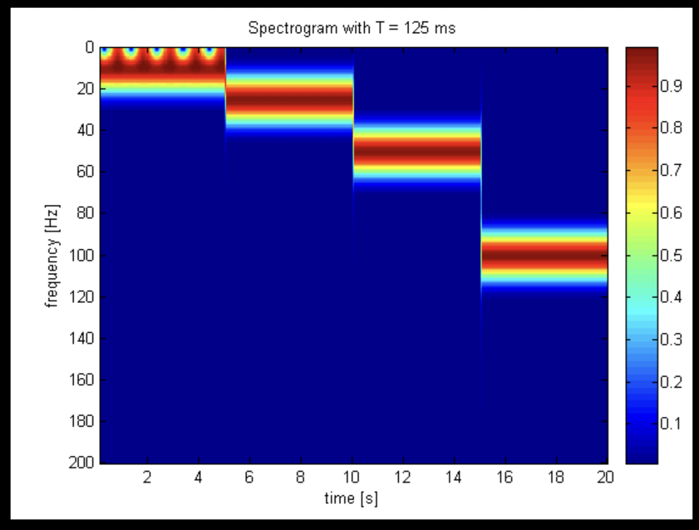
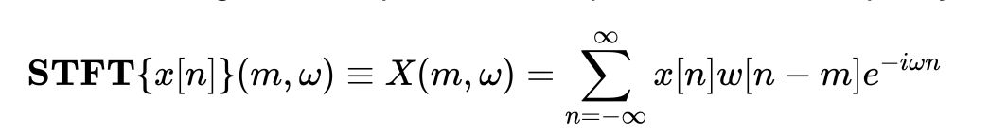
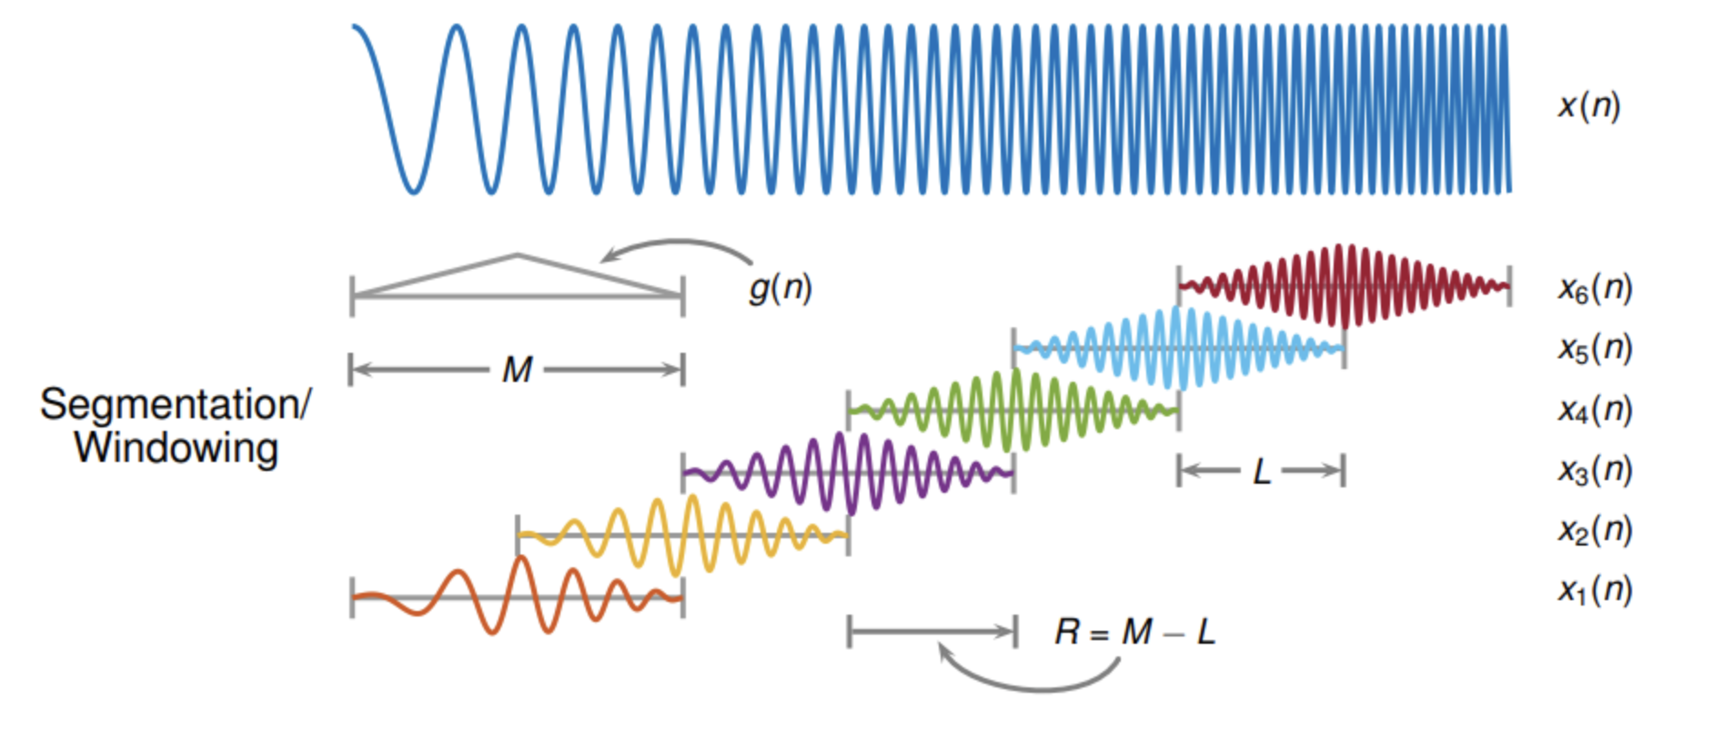
STM32 - ARM Filter & FFT
The short-time Fourier transform (STFT) is used to analyze how the frequency content of a nonstationary signal changes over time

Slide 12
STM32 - ARM Filter & FFT
Ideally, perform STFT on our audio recording and store in 2D array
1 second Sound Recording at 8192 Hertz: int32_t Audio[8192]
2D Spectrogram
frequency
TCP
time

Slide 13
STM32 - ARM Filter & FFT
Explore the Locality of STFT to process packets sequentially
1 second Sound Recording at 8192 Hertz: int32_t Audio[8192]
Size 256
frequency
frequency
frequency
TCP
TCP
TCP

Slide 14
STM32 - RTOS
Challenges:
User repeated button press
Wait for Server to Setup
Handle Interrupts
Solutions:
Multiple Threads for WIFI, DMA, FFT
Use blocking for interrupt triggers
Manage Priority

Slide 15

Rpi
Goal: Serve as a Wi-Fi server node connecting to a speaker via BLE. Utilize our ML model and Python libraries to efficiently control the speaker for loading and playing YouTube music.
Spectrogram
from STM32
BLE
Load URL

Slide 16
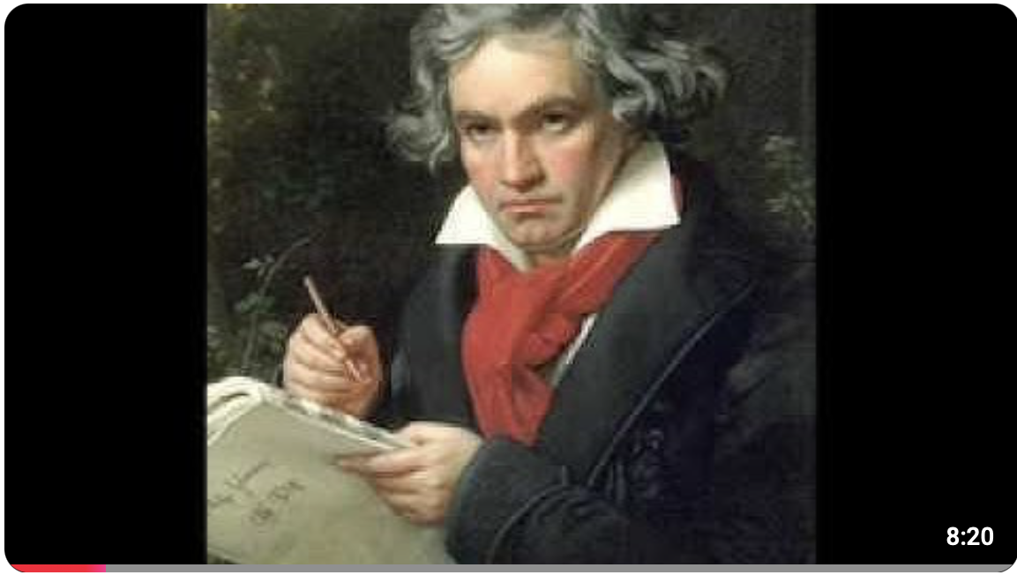
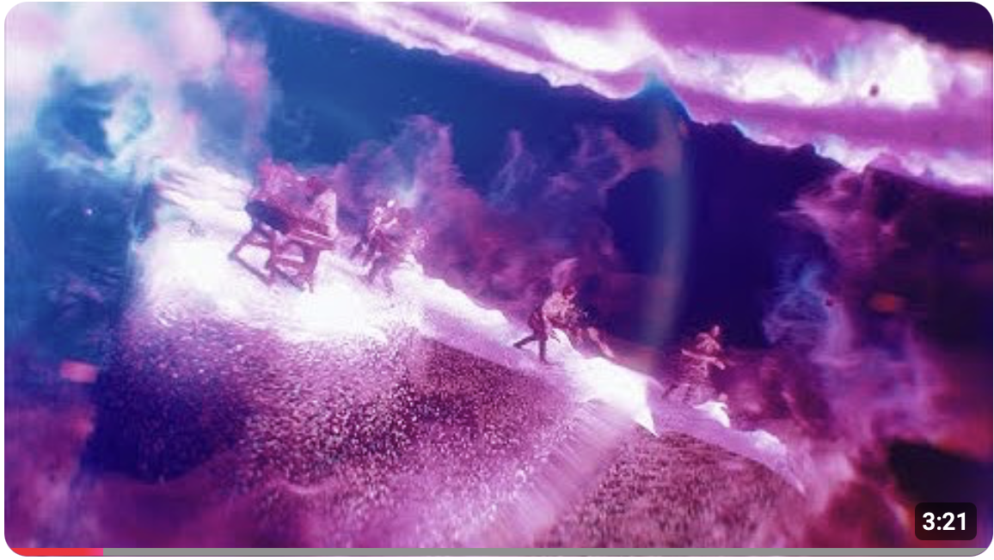

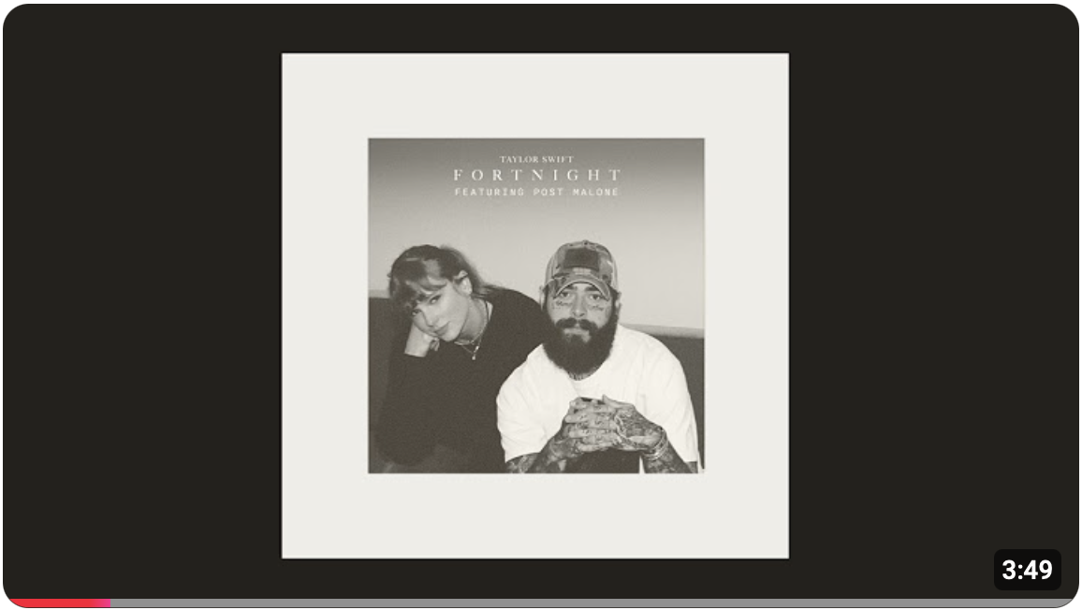
Rpi - YouTube Streaming
Classic
Python library used :
python-vlc 3.0.21203
yt-dlp 2024.12.13
Predetermined genre :
Classic
Rock
Pop
Hits
Predetermined a playlist for each genre
Rock
Pop
Hits

Slide 17
Rpi - ML Model
Challenges : A model for classifying 9 keywords is too difficult to train.
Solution : Split it into two different models :
Genre spotting : Select which playlist to be played
Command spotting : Select when or which song to be played
Genre spotting model classify received audio input into:
Classic
Rock
Pop
Hits
Command spotting model classify received audio input into:
Start
Pause
Next
Back
Choose

Slide 18
Rpi - Training Dataset Collection
Challenges :
The Google Speech Command Dataset does not contain our desired keywords.
Requires thousands of samples per keyword.
Solution :
Use pre trained Text-to-Speech model.
Library used : TTS 0.22.0
Pros : We can generate samples that match the format of those recorded on the STM32.
Cons : The model currently supports only about 109 different speakers.

Slide 19
Rpi - Training Dataset Augmentation
Challenges :
Model currently supports only about 109 different speakers
Falls significantly short of the target of 1,000.
Solution :
For each speaker augment the samples using the following techniques:
Pitch shifting
Time stretching
Adding noise
Adding reverberation
Adjusting volume
Randomly apply these parameters to generate 10 augmented samples.

Slide 20
Rpi - Customized Noise
Challenges :
Samples generated by the TTS model are overly clean
Recording conditions significantly different from STM32.
Solution :
We recorded background noise using the STM32
Randomly applied them to the audio samples .
Accuracy improve from 70% to 90%.

Slide 21
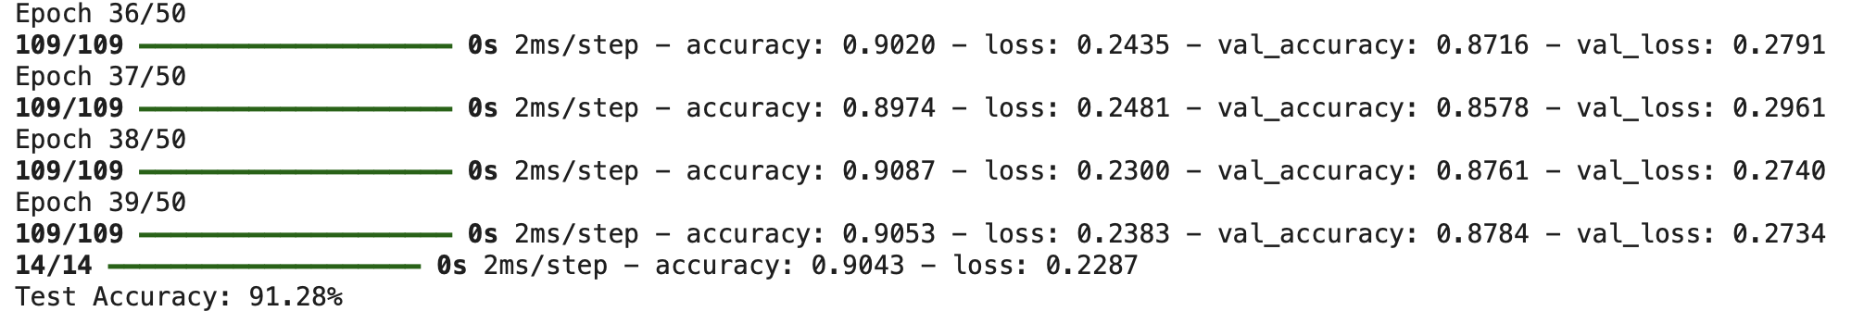

Rpi - Model Results
Command Spotting :
Genre Spotting :

Slide 22
Rpi - Finite State Machine
Genre State
Spot : Hits, Pop, Rock, Classic
Activate command spotting
Load YouTube URL depending on keyword
Spot : Choose
Activate genre spotting
Pause the music
Player State
Spot : Start, Pause
Play / pause the music
Spot : Next, Back
Update URL

Slide 23
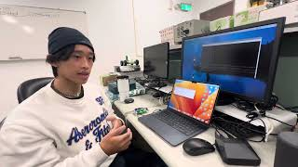
Results and Demonstration

